Slide 1
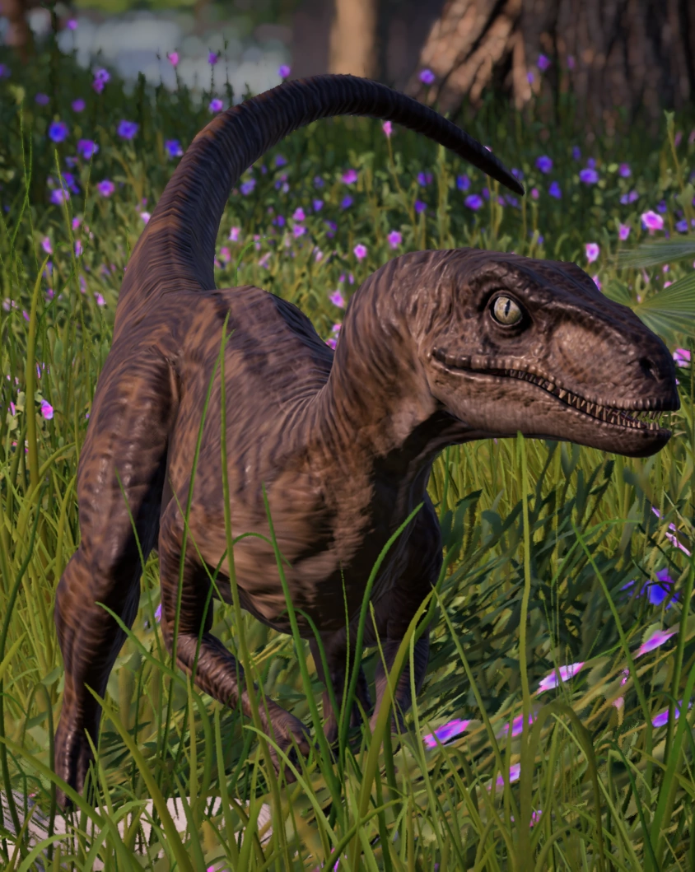
Dinosaur Discoverys
dinosaur facts discovery

Slide 2
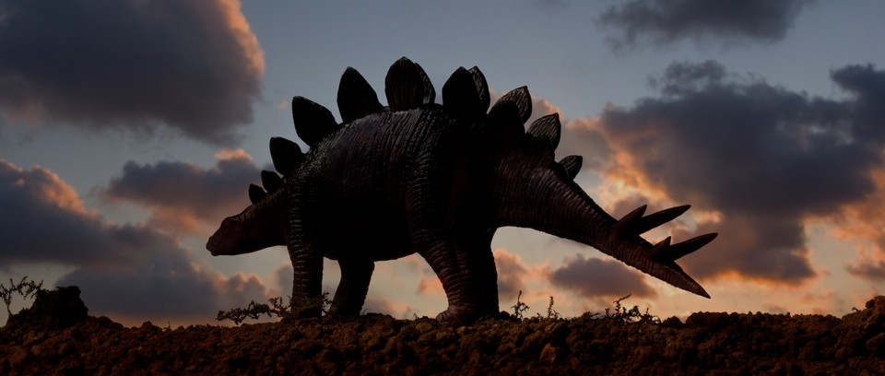
A stegosaurus is a plant eater

Slide 3
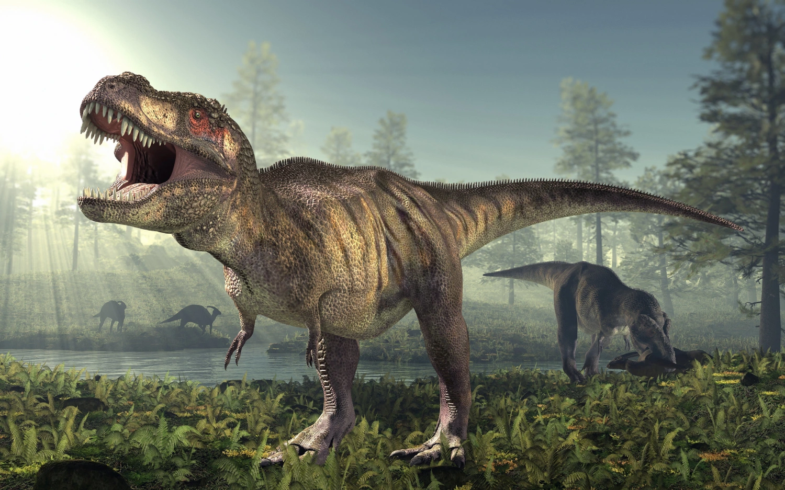
Trex had very good eyes and the are meat eaters.

Slide 4
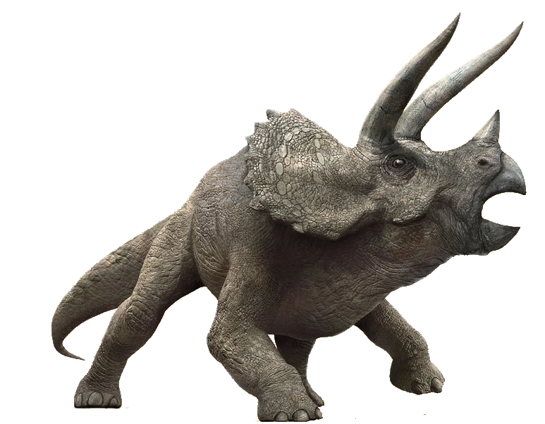
Triceretops are herbivors.

Slide 5
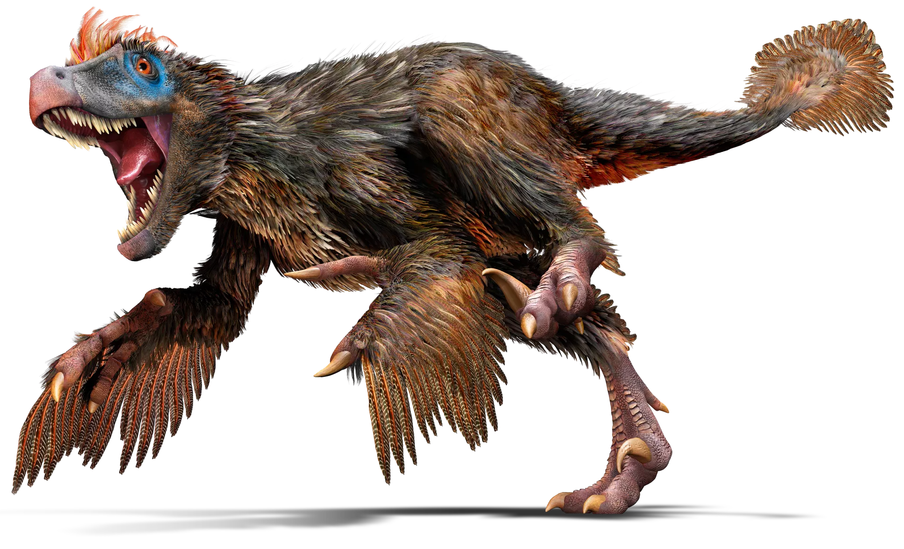
Velociraters are meat eaters and they are fast.

Slide 6
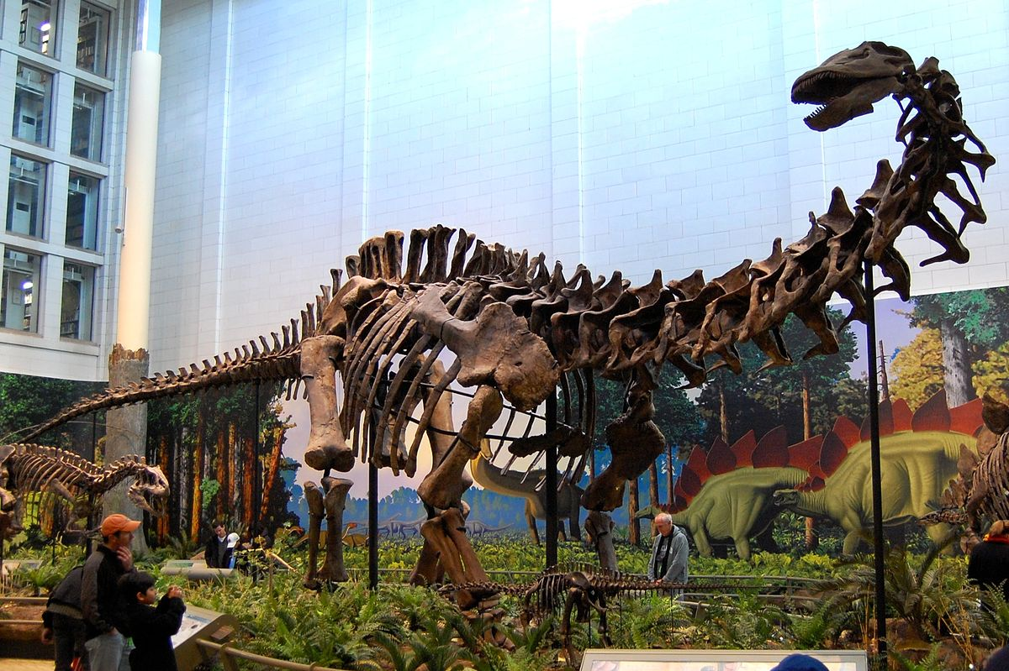
Apatosauruses has long necks.

