Slide 1

VIDEO GAMES!
AND FACTS ABOUT THEM

Slide 2
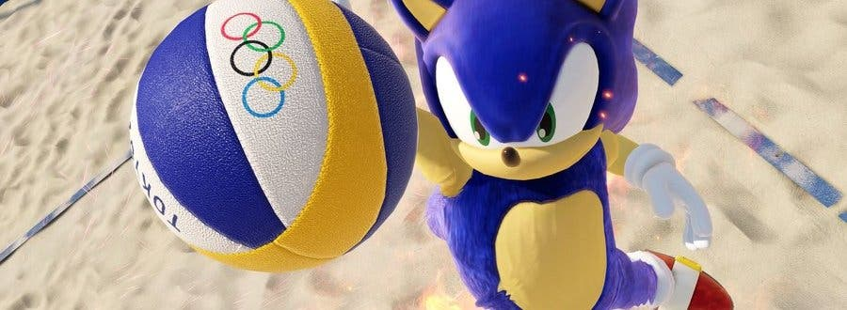
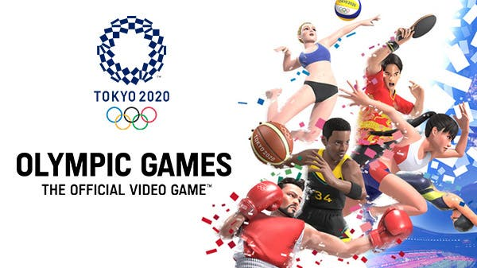
TOKYO 2020 OLYMPIC GAME
Tokyo 2020 Olympic game was released in July on the 22nd 2019

Slide 3
Minecraft
Whether you’re an avid player or have one in your life, you’ve probably had at least a brief encounter with Minecraft by now. Here are a few things you might not know about the gaming juggernaut.
In 2009, Swedish programmer and designer Markus Persson set out to create a sandbox game—one that allows for free and organic exploration of a virtual world—for the launch of his new company, Mojang AB. Persson began work on what is now Minecraft on May 10 of that year, amending the product in increments until May 16. The “alpha version” of Minecraft made its public debut the very next day

Slide 4
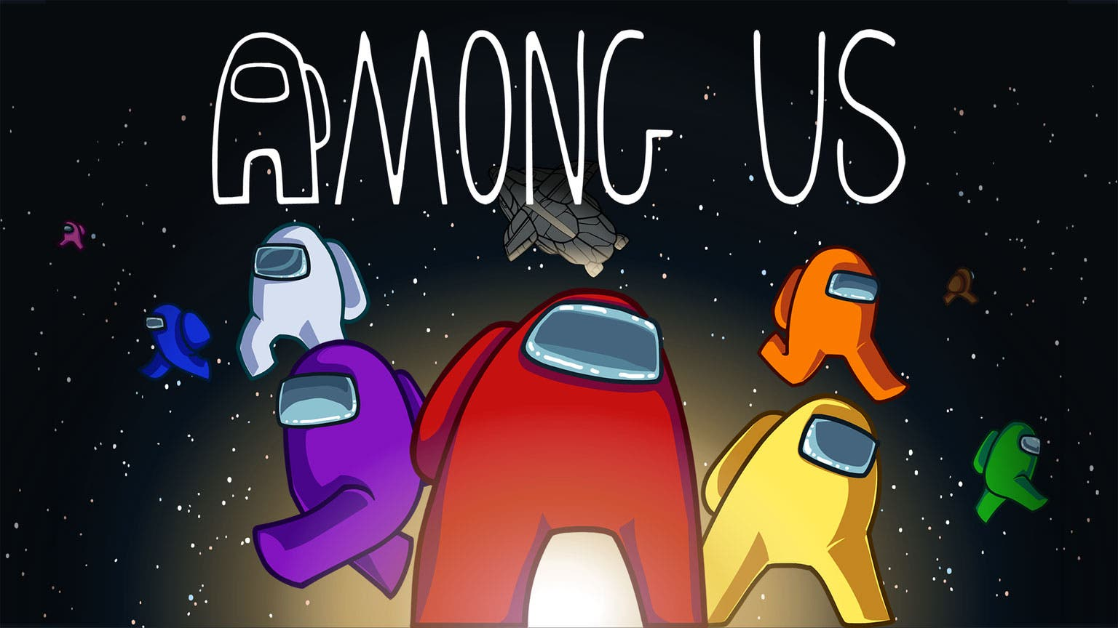
Among us!
More Than 85 Million Downloads. With an increasing number of people hearing about the game, the number of downloads increased by an exponential rate in 2020.
Among us was Developed by a Team of Three. Among Us was developed by Forest Willard, Amy Liu and Marcus Bromande. The developer, Innersloth, is a company based in Washington.

Slide 5
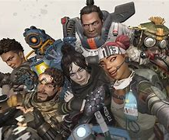
Apex legends
Here's some facts!
Apex Legends is a part of the Battle Royale genre, which is one of the most popular genres for gamers in the world.
The game is set in the Titanfall universe.
The game has a Titanfall twist as the game has Titans and unique abilities.
The game features a roster of eight playable Legends.
There are various modes in the game including single player, team-up, and live-fire training.
Weapons in-game also have a rarity level, which ranges from Common to Legendary.
Players can team up with a maximum of three other players in a squad.
Apex Legends has no story mode.
The game was released on 4th of February 2019.
Apex Legends is free-to-play and has no ads

Slide 6
Far cry!
Far Cry is a franchise of first-person shooter games, all of which have been published by Ubisoft. The first game, Far Cry, was developed by Crytek to premiere their CryEngine software, and released in March 2004.
Here are 2 facts!
92% of people enjoyed this game
2. PlayStation 4, Xbox One, Microsoft Windows, Google Stadia are the platforms

