Slide 1
Different Popular Hairstyles Through The Decade!
By Hawa and Malayeka

Slide 2
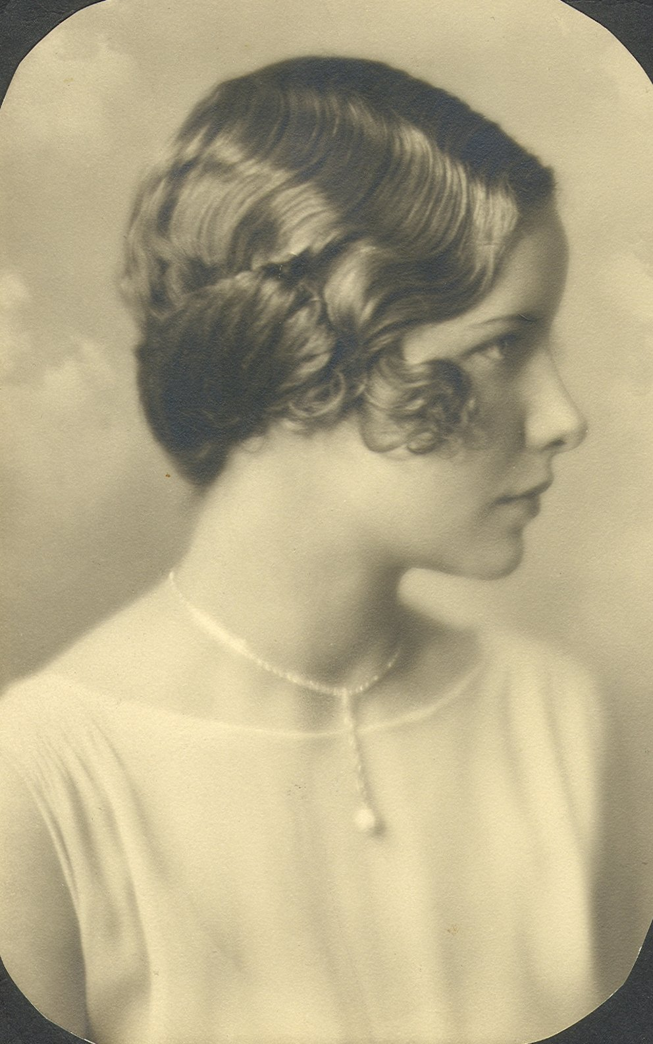
Classic Finger Curls (30s
A finger wave is a method of setting hair into waves (curls) that was popular in the early 1930s and again in the late 1990s in North America and Europe. Silver screen actresses such as Josephine Baker and Bette Davis are credited with the original popularity of finger waves.
Finger waves were developed in the 1930s to add style to, and soften the hard appearance of, the bobbed hairstyles that became very popular during the flapper period.

Slide 3
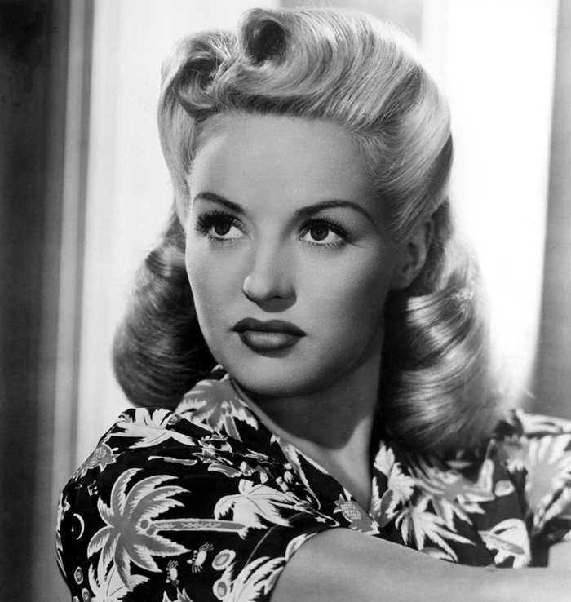
Victory rolls (40s
Victory rolls are a women's hairstyle that was popular from 1940 to 1945, characterized by voluminous curls of hair that are either on top of the head or frame the face. Victory rolls are closely associated with the pin-up look and are achieved using various backcombing, rolling, pinning, and curling techniques.
The creator of the victory rolls is unknown, but several theories exist on the style's origins. The hairstyle has received a resurgence in popularity via themed parties and the swing dance scene.

Slide 4
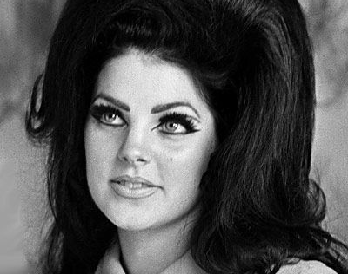
The Bouffant (50s
The style became popular at the beginning of the 1950s when First Lady Jaqueline Kennedy was often photographed with her hair in a bouffant, and her style was widely imitated. Generally speaking, by the mid-1950s, many well-dressed women and girls were wearing some form of bouffant hairdo, which in one variation or another remained the fashionable norm until supplanted by the geometric bob cut at the end of the decade and the looser shag or feathered styles of the early 1950s.

Slide 5
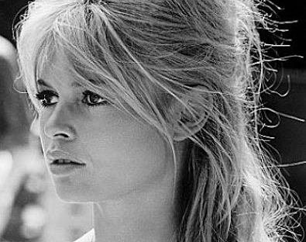
The bombshell (60s
This is perhaps the most popular hairstyle for pinup photos and burlesque performers, and epitomizes the bombshell goddess of the 1960s.

Slide 6
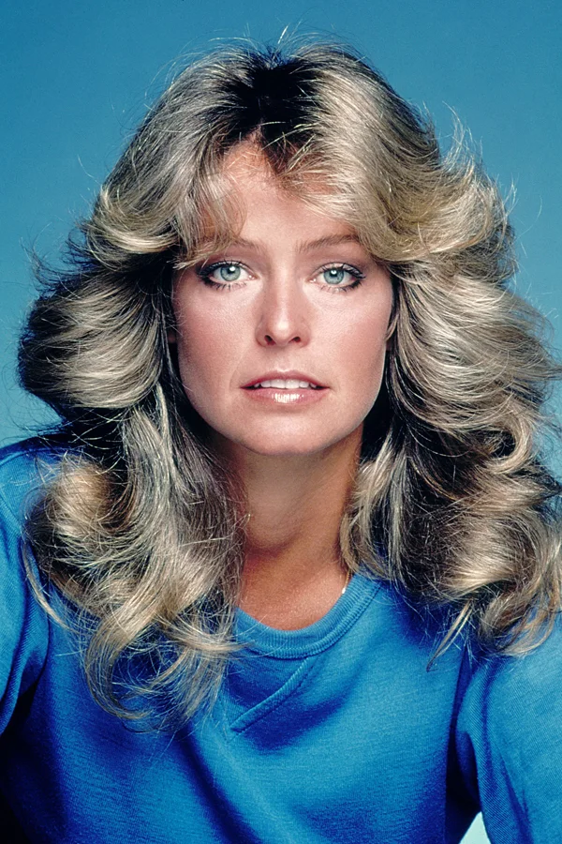
Disco hair (70s
Disco hair was inspired by both African and Caucasian hair types. Many feverish styles were created by letting tight curls grow haphazardly, while others took hot rollers and a few cans of hair spray to ensure their longevity under the disco ball.

Slide 7
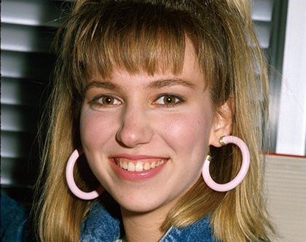
The Whale Spout Pony (80s
The whale spout pony was a very trendy hairstyle in the 1980’s.

Slide 8
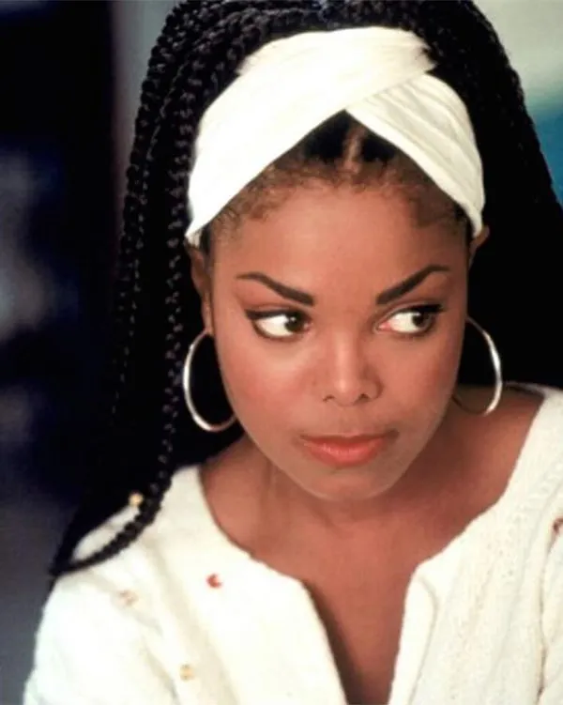
High braids (90s
High braids hairstyle in the 90s were very popular because the actress Janet Jackson’s wore braids in the movie Poetic Justice.

Slide 9
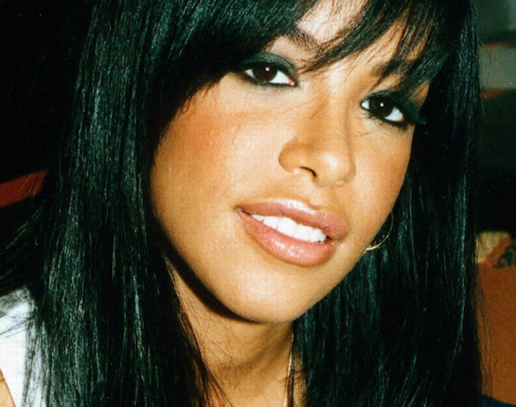
Aaliyah Bangs (00S
Aaliyah bangs was a hairstyle a person named Aaliyah invented it was a very fashionable hairstyle.

